Slide 1
Next Generation Science Standards as a Tool to Guide Student Learning Objectives and Science Instruction.
Office of Leadership Development and School Improvement

Slide 2
Access Workgroup Resources
https://www.marylandresourcehub.com
PowerPoint presentations​
Supporting Resources

Slide 3
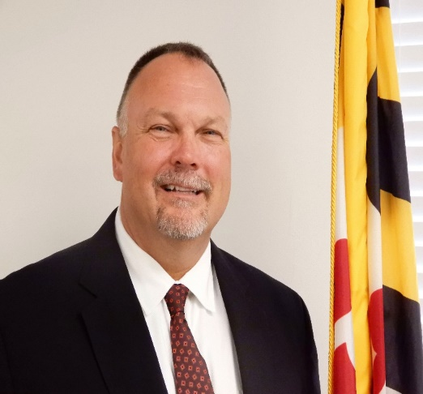
Presenters: Maryland State Department of Education
Edmund Mitzel, Coordinator of Leadership Development
Dr. Brian Eyer, Leadership Development Specialist

Slide 4
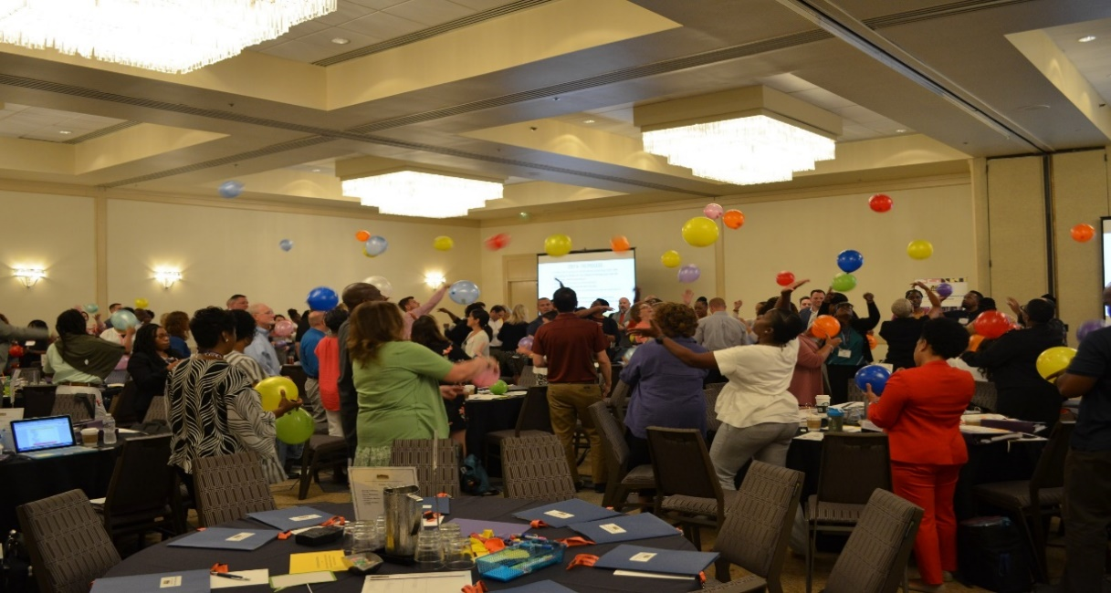
Session Objectives:
By the end of the session today we will have:
Reviewed the data for teacher effectiveness and achievement gaps;
Analyzed equitable practices in the science classroom and school; and
Applied Student Learning Objective (SLO) tools to construct quality SLOs that yield equitable practices.

Slide 5
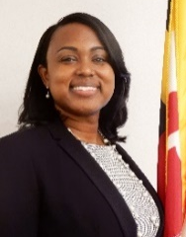
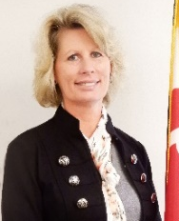
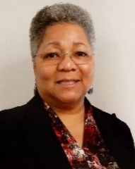
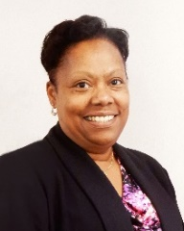
The Office of Leadership Development and School Improvement
Fostering the Growth of Effective Leaders
Provide targeted professional learning experiences and resources to equip current and future leaders with the skills and knowledge required for successful school and district leadership.
Ensuring Valid and Reliable Evaluations
Oversee the development and implementation of Maryland’s teacher and principal evaluation system. Training, guidance, and support is provided to local school systems in the implementation of fair and valid evaluations.
http://marylandpublicschools.org/about/Pages/OTPE/index.aspx
Raising the Quality of Education
Provide customized professional learning experiences and support, informed by data and grounded in effective practices, to improve school performance.

Slide 6
For the Last 3 Years, Most Maryland Teachers were Rated as Highly Effective or Effective

Slide 7
School Systems range from reporting 92% Highly Effective Teachers to Less than 2% Highly Effective Teachers

Slide 8
Connecting State Student Achievement to Effectiveness Ratings
31.7% of Students
Earned a Level 4 or 5 on the
Algebra I State Assessment
Over 95% of Principals and Teachers
Rated Effective or Highly Effective
43.1% of Students
Earned a Level 4 or 5 on ELA/L 10
State Assessment

Slide 9
Percent of Students at Performance Level 4 or Higher by Race/Ethnicity, 2015-2018, ELA 3-8

Slide 10
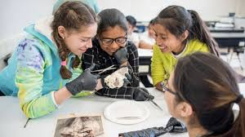
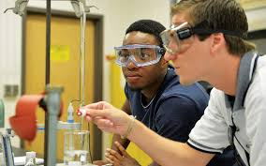
Ensuring All Students Learn Science
“The Next Generation Science Standards (NGSS) offer a vision of science teaching and learning that presents both learning opportunities and demands for all students, particularly student groups that have traditionally been underserved in science classrooms.” -- Next Generation Science Standards: All Standards, All Students
“Learning science depends not only on the accumulation of facts and concepts but also on the development of an identity as a competent learner of science with motivation and interest to learn more” -- NRC, 2012
Student demographics across the nation are changing rapidly with an increase of student diversity in the classrooms and we continue to see achievement gaps in science and other key academic indicators among demographic subgroups. - - "All Standards, All Students”: Making the Next Generation Science Standards Accessible to All Students

Slide 11
How are you moving from average to every?

Slide 12
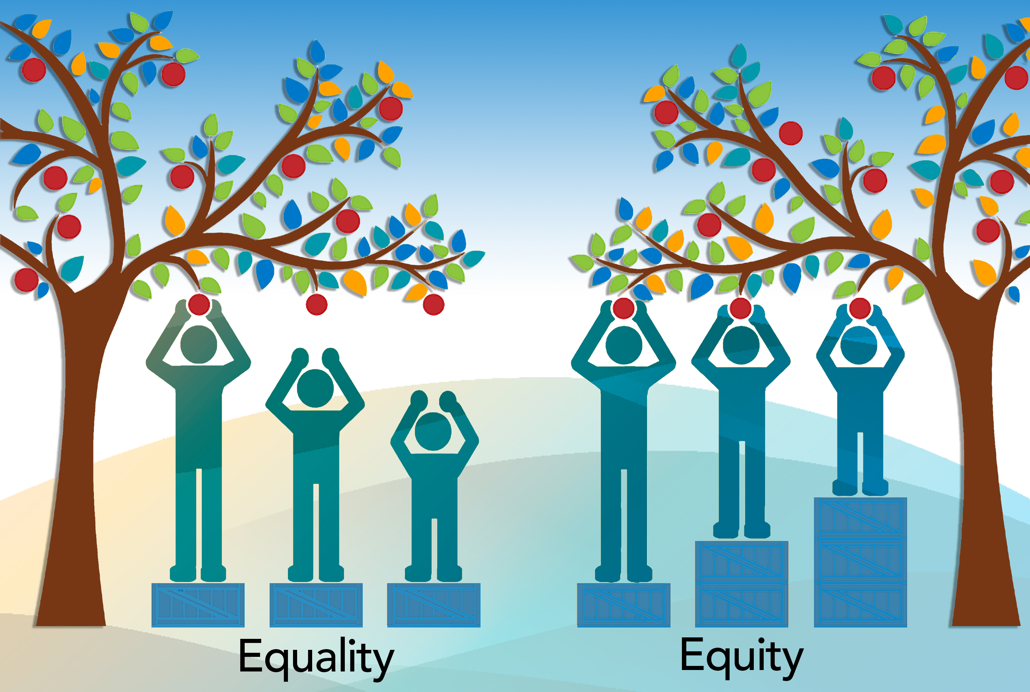
Equity and Equality

Slide 13
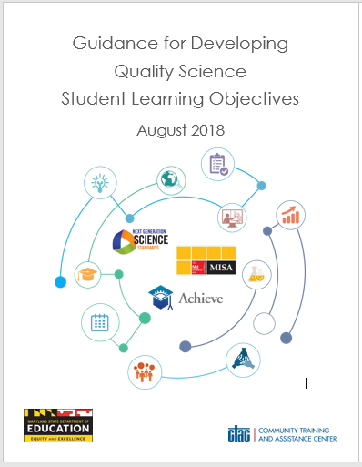
“If nothing ever changed, there would be no butterflies”

Slide 14
Spotlight on Standard 3
Standard 3. Equity and Cultural Responsiveness
Effective educational leaders strive for equity of educational opportunity and culturally responsive practices to promote each student’s academic success and well-being.

Slide 15
The desire to serve… The ability to perform… The courage to act

Slide 16
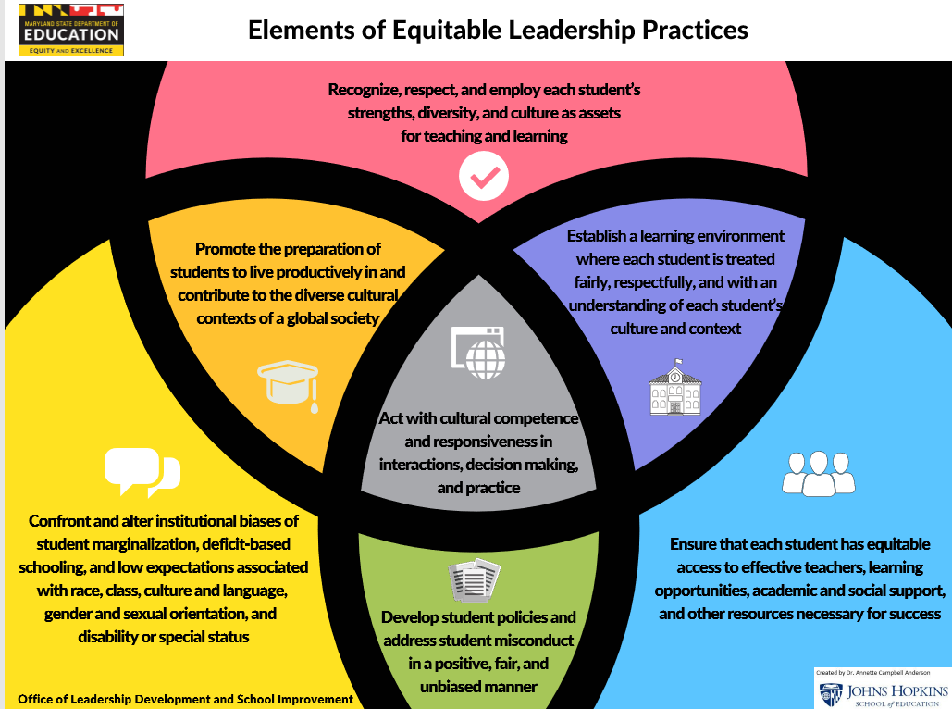
Elements of Equitable Leadership Practices

Slide 17
Equity Exercise
Green Dot - Highly Effective.
Yellow Dot - Effective.
Blue Dot - Developing.
Red Dot - Ineffective

Slide 18
NGSS Provide Opportunities for Diversity and Equity

Slide 19
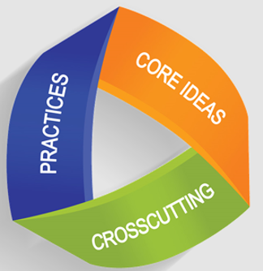
Cross Cutting Concepts for Diversity

Slide 20
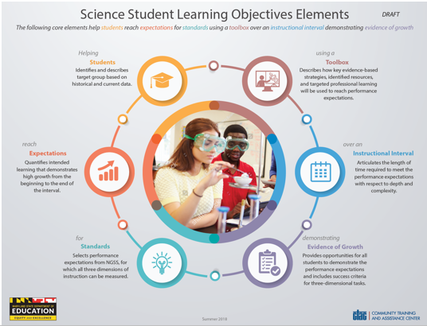
Science Student Learning Objectives Elements

Slide 21
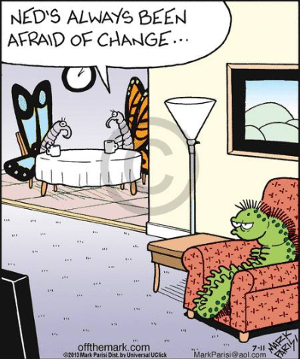
Elements of a Science Student Learning Objective
Each group is to answer the following questions based upon their assigned element:
What does this element focus on and why is it important?
From our equity discussion what strategies can you employ to ensure that this element is designed with all students in mind?
How is your current SLO designed for your classroom, department, or school to demonstrate equitable instructional practices?

Slide 22
Students
Identifies and describes target group based on historical and current data.

Slide 23
Expectations
Quantifies intended learning that demonstrates measured growth from the beginning to the end of the interval.

Slide 24
Standards
Selects performance expectations from NGSS, for which all three dimensions of instruction can be measured.

Slide 25
Toolbox
Describes how key evidence-based strategies, identified resources, and targeted professional learning will be used to reach performance expectations.

Slide 26
Instructional Interval
Articulates the length of time required to meet the performance expectations with respect to depth and complexity.

Slide 27
Evidence of Growth
Provides opportunities for all students to demonstrate the performance expectations and includes success criteria for three-dimensional tasks.

Slide 28
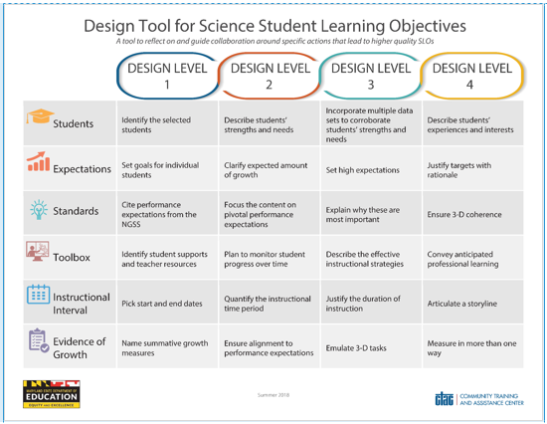
Student Learning Objective Samples
Review one of the SLOs on your table and use the design tool to analyze the SLO
Identify areas to strengthen the SLO
How is equity present or absent in this SLO

Slide 29
Guide for Developing Quality Science Student Learning Objectives

Slide 30
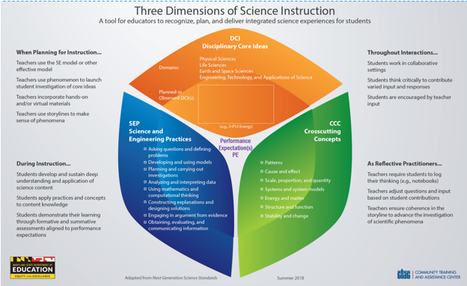
Three Dimensions of Science Instruction

Slide 31
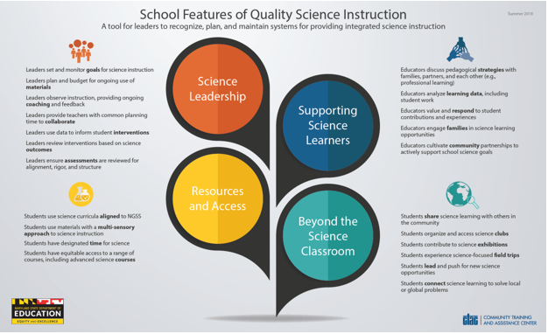
School Features of Quality Science Instruction

Slide 32
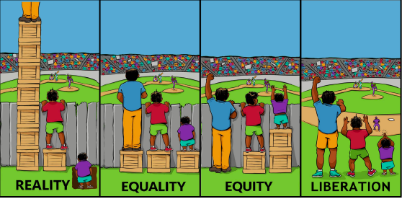
The Reality Regarding Equity

Slide 33
Office of Leadership Development and School Improvement
Ed Mitzel Coordinator of Leadership Development Edmund.Mitzel@Maryland.gov 410-767-0348
Contact Us With Any Questions
Dr. Brian Eyer Leadership Development Specialist Brian.Eyer@Maryland.gov 410.767.0725
Access resources at the
Maryland Resource Hub:
www.marylandresourcehub.com
http://marylandpublicschools.org/about/Pages/OTPE/index.aspx

